Slide 1
Carver Public Schools
2015 Budget Presentation

Slide 2
Level Service Budget
Each year we prepare a LEVEL SERVICE budget to begin the budget process.
This means NO GROWTH in personnel or programs.
Projected increases in expenses are included in this budget.
Projected increases are to MAINTAIN current level of programs and personnel.

Slide 3
Budget Building Blocks
Projected Expenses
Projected Revenues
Projected Revenue
Offsets

Slide 4
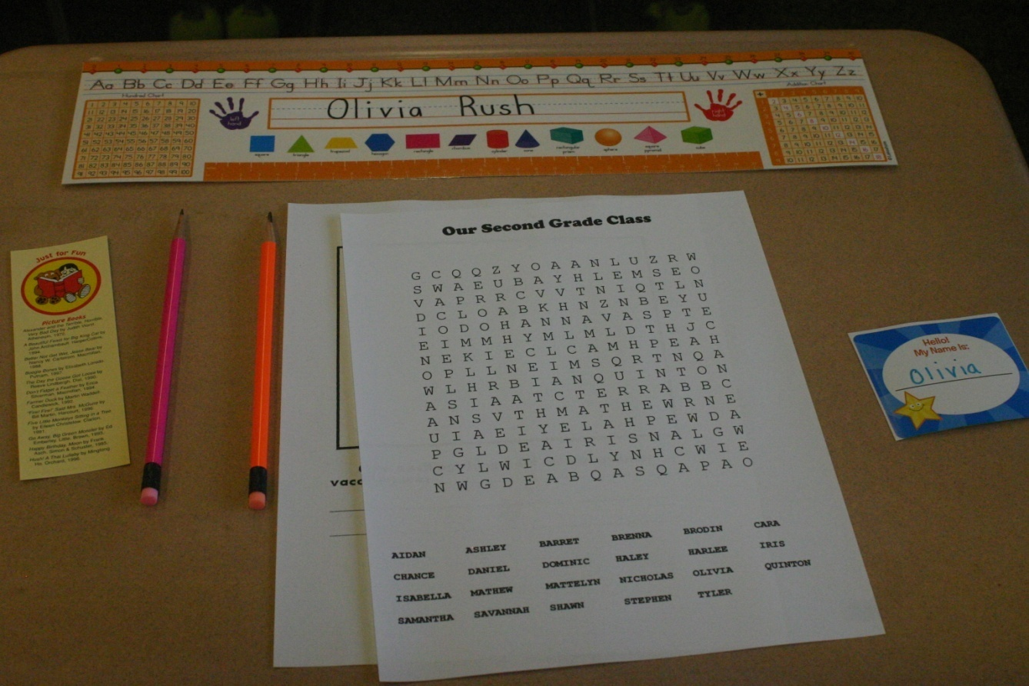
Projected Expense
The following slides outline expenses by COST CENTER.

Slide 5
Analysis By Cost Center: Central Office
FY 2014 Budget | FY 2015 Budget | Inc/ (Dec) | % Change
$5,757,067 | $5,987,997 | $230,930 | 4.01%
Reasons for change:
Increase in Health Insurance $192,000
Additional Increase in Plymouth County Retirement-$ 40,000
Increase FICA payroll obligation
No offset from Ed Jobs Bill
Slight Reduction in Vocational/Aggy tuitions for next year

Slide 6
Analysis By Cost Center: Transportation
FY 2014 Budget | FY 2015 Budget | Inc/ (Dec) | % Change
$218,740 | $218,740 | $0 | 0.00%
Reasons for change:
No increase

Slide 7
Analysis By Cost Center: Special Education
FY 2014 Budget | FY2015 Budget | Inc/ (Dec) | % Change
$581,445 | $1,437,663 | $856,218 | $147.26%
Reasons for Change:
Increase in private out - of - district tuitions
Increase in collaborative tuitions
Increase in enrollment
Increase in services, transportation, time at facility, and equipment

Slide 8
Analysis By Cost Center: Custodial/Maintenance
FY 2014 Budget | FY 2015 Budget | Inc/ (Dec) | % Change
$374,141 | $374,141 | $0 | 0.00%
Reasons for change:
No change- this is a risk due to the age and condition of the older school buildings.

Slide 9
Analysis By Cost Center: Technology
FY 2014 Budget | FY 2015 Budget | Inc/ (Dec) | % Change
$130,669 | $92,367 | ($38,302) | -29.31%
Reasons for change
No Change

Slide 10
Analysis By Cost Center:
Elementary School
FY 2014 Budget | FY 2015 Budget | Inc/ (Dec) | % Change
$137,545 | $137,031 | ($514) | -0.37%
Reasons for Change:
Minimal change in cost of services
Cost per student ($137,031/849) = $161.40

Slide 11
Analysis By Cost Center:
Middle High School
FY 2014 Budget | FY 2015 Budget | Inc/ (Dec) | % Change
$ 213,095 | $212,961 | ($134) | -0.06
Reasons for Change:
Minimal decrease in cost for services
Cost per student ($212,961/878) = $242.55

Slide 12
Analysis By Cost Center:
Athletics
FY 2014 Budget | FY 2015 Budget | Inc/ (Dec) | % Change
$85,109 | $88,705 | $3,596 | 4.23%
Reasons for Change:
Transportation and Officials

Slide 13
Analysis By Cost Center:
Salaries
FY 2014 Budget | FY 2015 Budget | Inc/ (Dec) | % Change
$13,870,481 | $14,350,694 | $480,213 | 3.46%
Reasons for Change:
Contractual Obligations

Slide 14
Summary Totals of All Cost Centers
FY 2014 Budget | FY 2015 Budget | Inc/ (Dec) | % Change
$21,368,292 | $22,900,299 | $1,191,706 | 5.59%
FY 2014 Reflects Adjustments (Revenue Offsets):
Ed Jobs $0.0
Circuit Breaker $ 563,478
School Choice $ 95,000
Additional Ch 70 $ 43,900
Total $ 702,378

Slide 15
Summary Totals of All Cost Centers
FY 2014 Budget | FY 2015 Budget | Inc/ (Dec) | % Change
$21,368,292 | $22,900,299 | $1,532,007 | 7.17%
FY 2015 DOES NOT Reflect Adjustments (Revenue Offsets)
Possible but not confirmed adjustments for FY2015
Additional Ply Cty
- retiree Health Ins $ - 22,082
Circuit Breaker $ 510,000
School Choice $ 90,000
d. Addtl Ch 70 $ 42,850
Total $ 666,820 $913,125 SHORT FALL

Slide 16
Projected Revenues
Fiscal Year 2015

Slide 17
Chapter 70
Level Funded from 2014 to 2015
(Governor's Budget 1/2013) + $25/student
$9,688,439 ₊ $42,850 = 9,731,289

Slide 18
Town of Carver
Projected Increase of 0%
Actual Number Not Known at this time

Slide 19
Chapter 70 + Town of Carver
Chapter 70 (FY2015) $ 9,731,289
Town of Carver (FY2015) $ ???
Total $ ???
Includes $42,850 additional Chapter 70
Not Included Circuit Breaker and School Choice Offset $

Slide 20
Projected Level Service Gap Without Additional Adjustments
$22,900,299Level Service
$?????? Total Projected Revenue
_________________________
$ 913,125 Gap (with level funding from Town)

Slide 21
$913,125 Gap
Possible sources to offset the GAP
Retirement notifications are still in process
Unknown Town contribution- does not look like
there will be a projected increase-hoping for no decrease

Slide 22
Teacher Layoffs
If nothing changes from the Revenue Projections
12 Teachers at each school will be laid off
Total of 24 Teachers
As a result :
K classes will remain the same, but 1-5 would average between 29-34 students per class
Grades 6-12 most classes will increase in size-some will average 29-30

